Slide 1
Convolutional Neural Networks
Lecture-09

Slide 2
What is deep learning?
Deep learning is part of a broader family of machine learning methods based on artificial neural networks with representation learning.
ANN in its simplest form has only three layers
An ANN that is made up of more than three layers – i.e. an input layer, an output layer and multiple hidden layers – is called a ‘deep neural network’.
Deep learning architectures such as convolutional neural networks, deep belief networks, recurrent neural networks, etc.

Slide 3
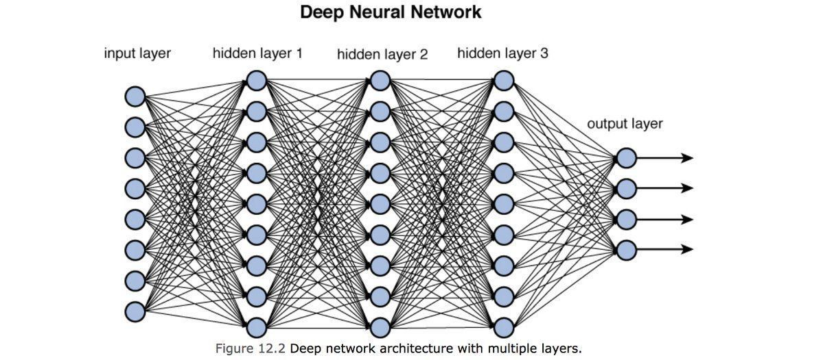

Slide 4
ConvNet
A supervised deep learning method.
A Convolutional Neural Network (ConvNet/CNN) is a Deep Learning algorithm which can take in an input image, assign importance (learnable weights and biases) to various aspects/objects in the image and be able to differentiate one from the other.
The role of the ConvNet is to reduce the images into a form which is easier to process, without losing features which are critical for getting a good prediction.

Slide 5
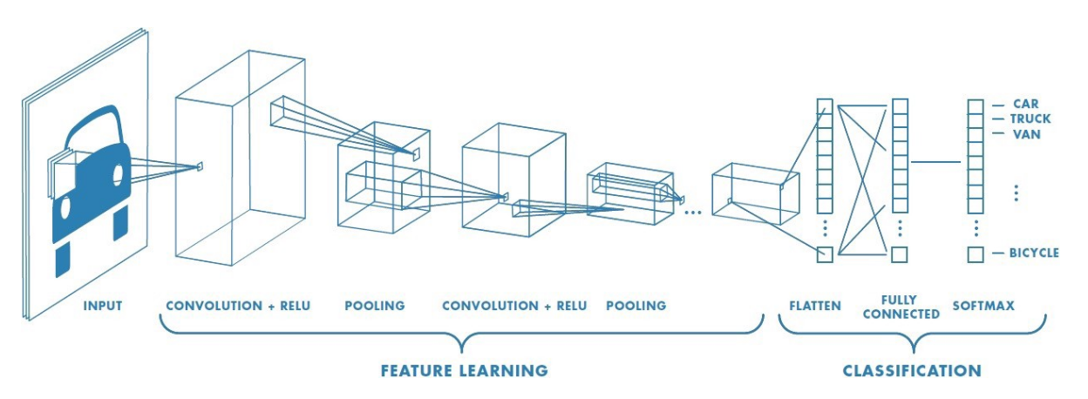
A typical ConvNet

Slide 6
Types of Layer in CNN
Convolution
Pooling
Fully Connected

Slide 7
Why Convolutional Layer
One of the challenges of computer vision problem that can be so large and we want a fast and accurate algorithm to work with that.
For example, a 1000x1000 image will represent 3 million feature/input to the full connected neural network. If the following hidden layer contains 1000, then we will want to learn weights of the shape [1000, 3 million] which is 3 billion parameter only in the first layer and thats so computationally expensive!
One of the solutions is to build this using convolution layers instead of the fully connected layers.

Slide 8
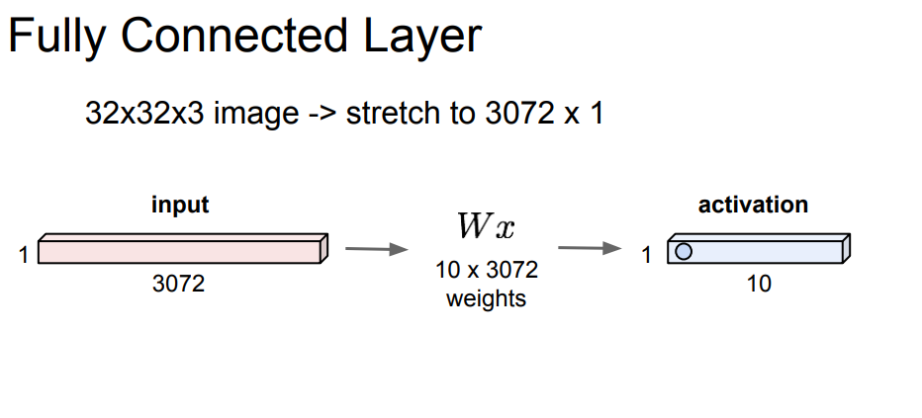
Why ConvNet?

Slide 9
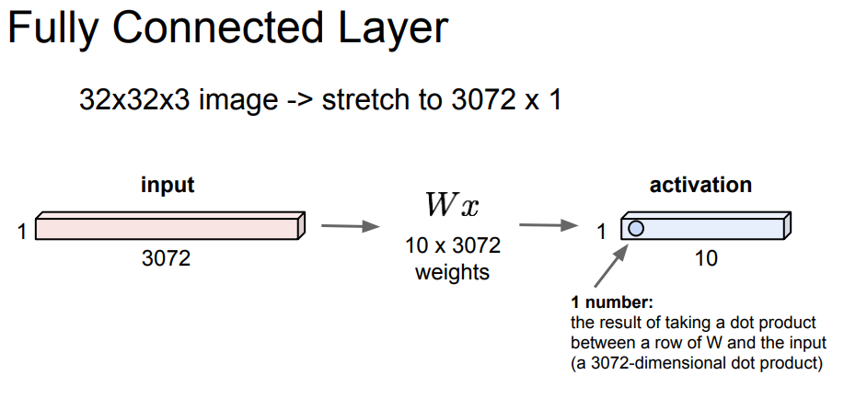
Why ConvNet?

Slide 10
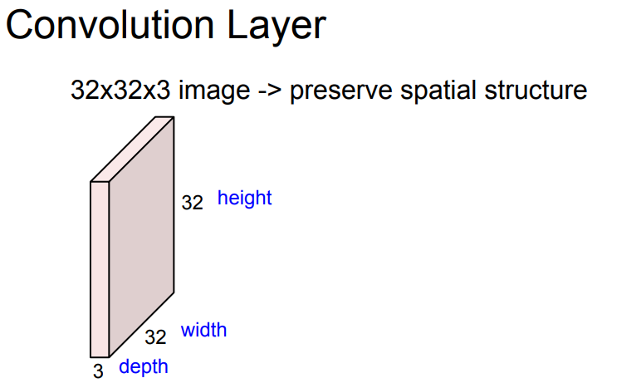
Why ConvNet?

Slide 11
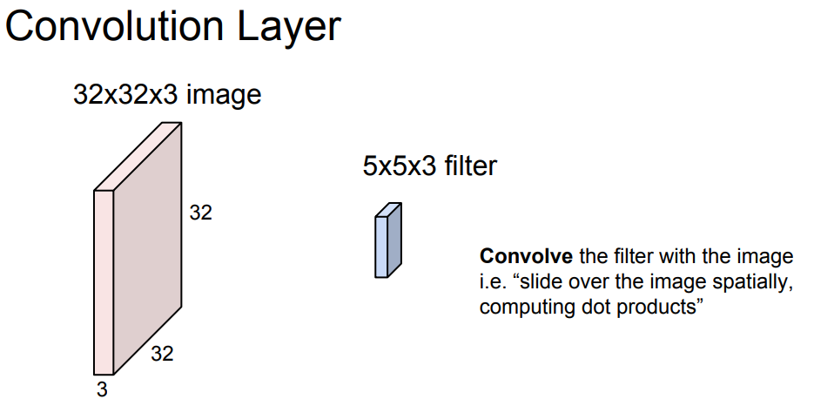
Why ConvNet?

Slide 12
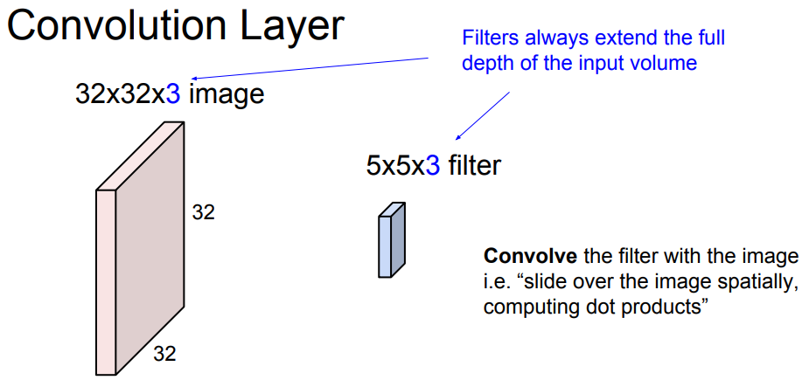
Why ConvNet?

Slide 13
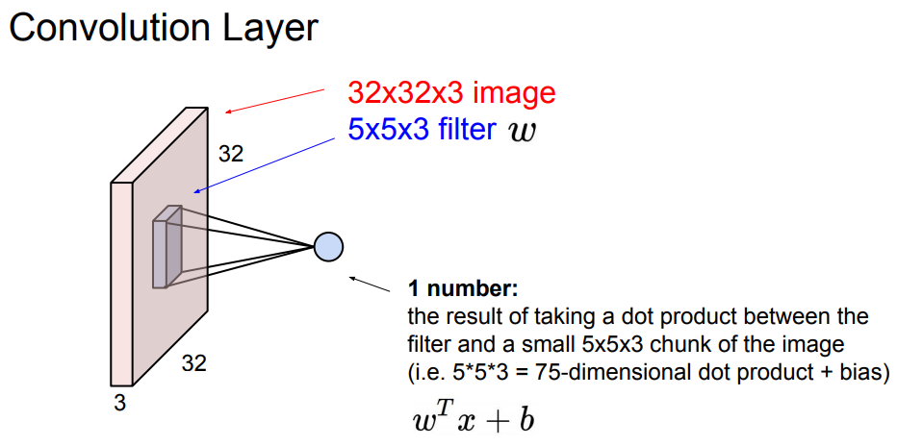
Why ConvNet?

Slide 14
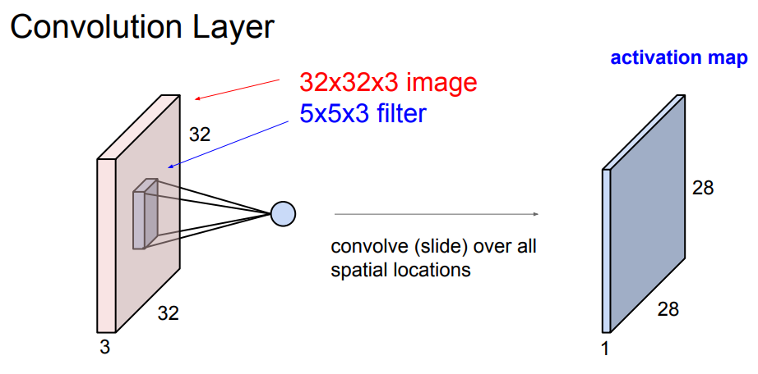
Why ConvNet?

Slide 15
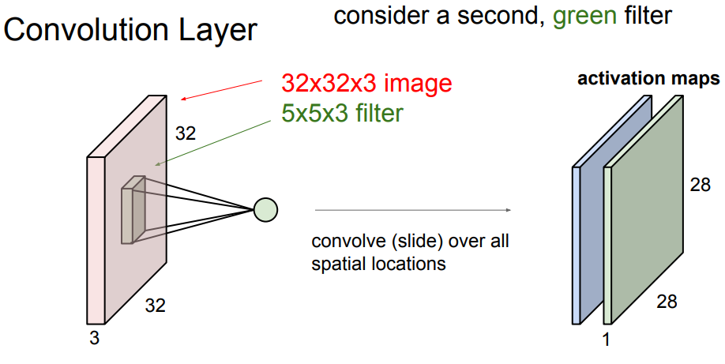
Why ConvNet?

Slide 16
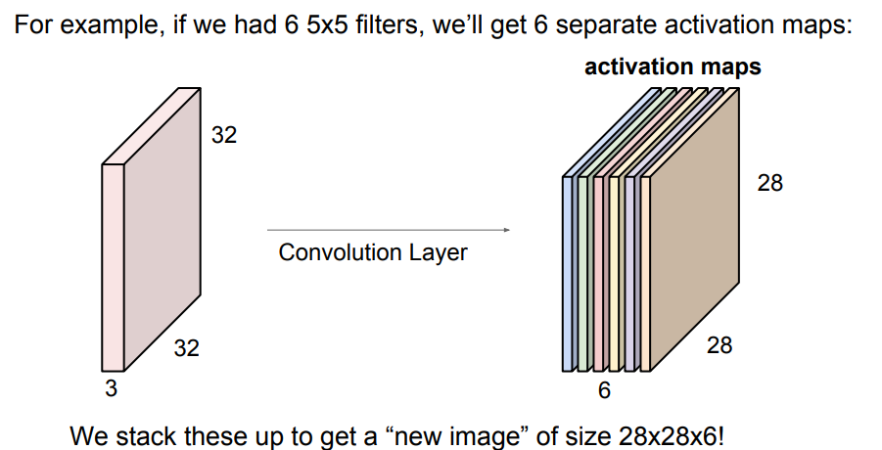
Why ConvNet?

Slide 17
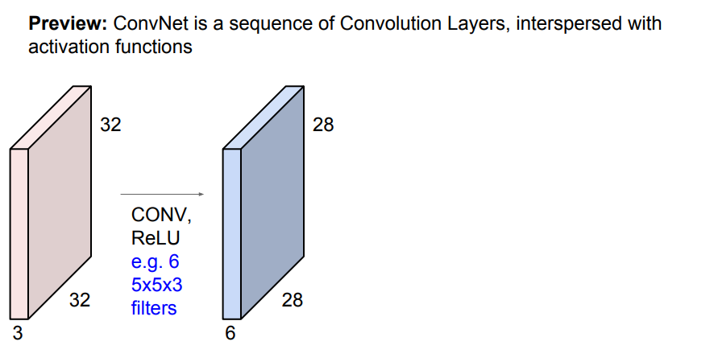

Slide 18
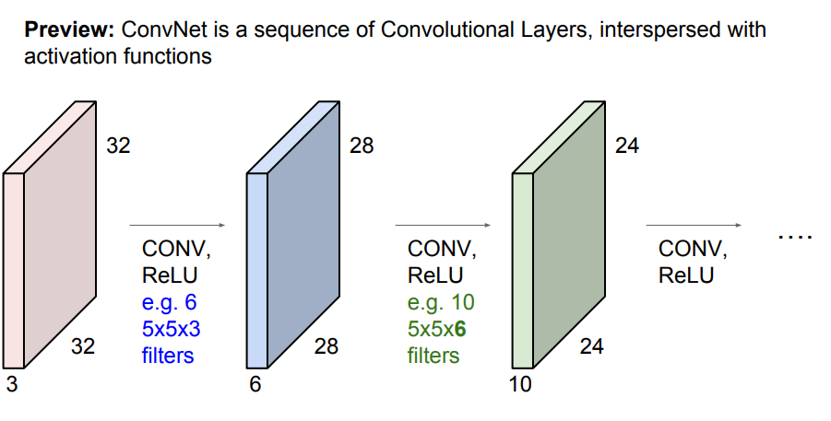

Slide 19
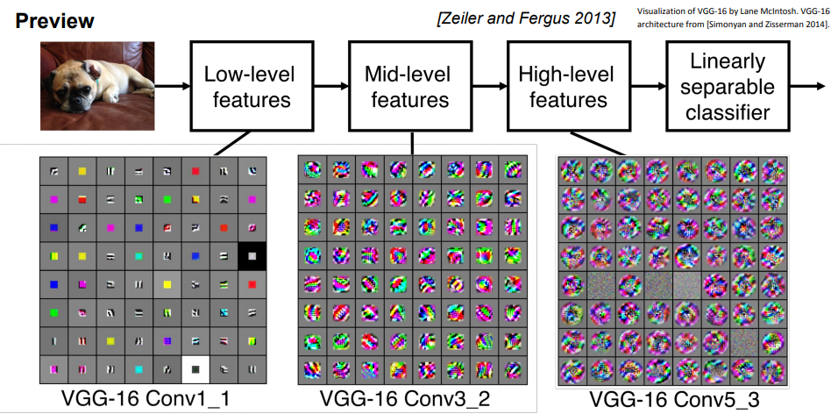

Slide 20
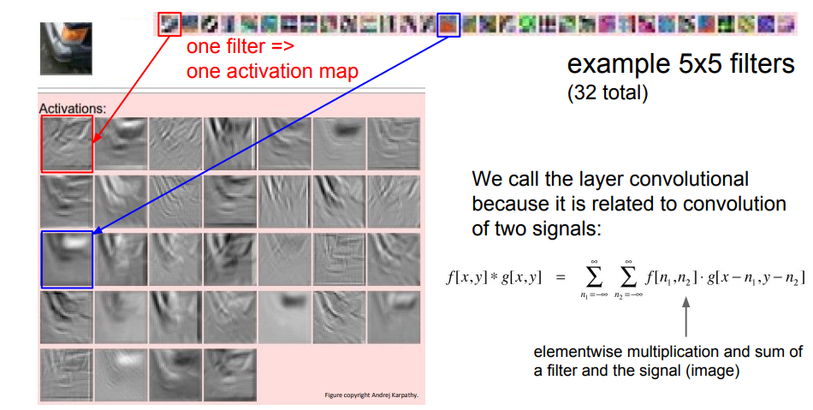

Slide 21
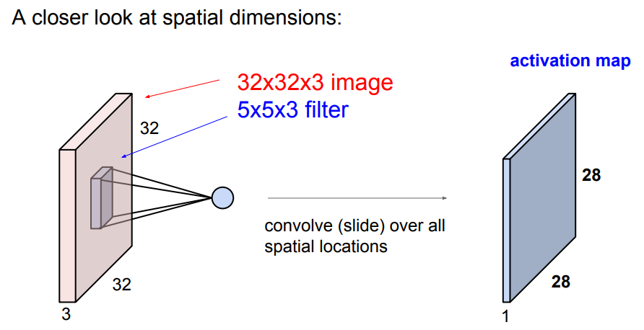

Slide 22
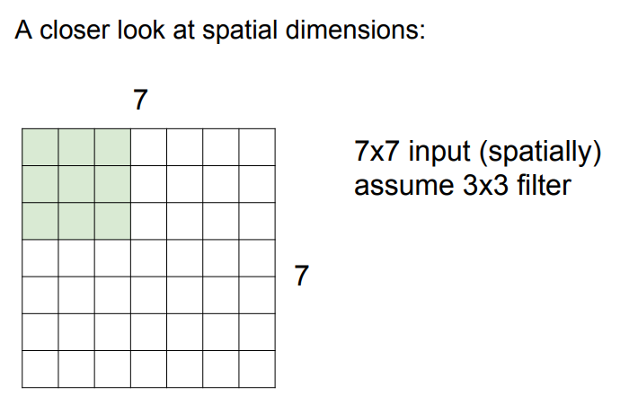

Slide 23
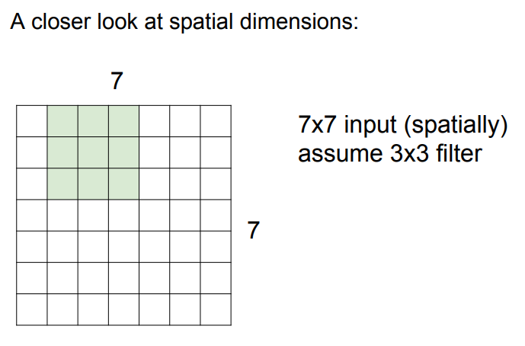

Slide 24
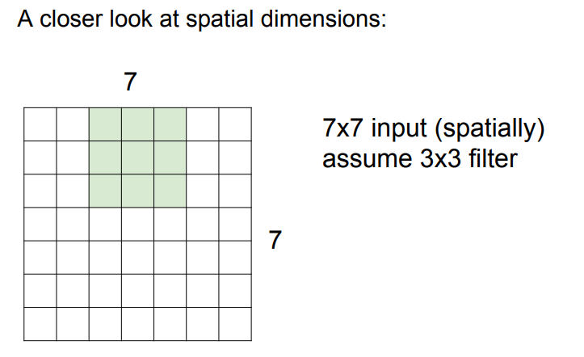

Slide 25
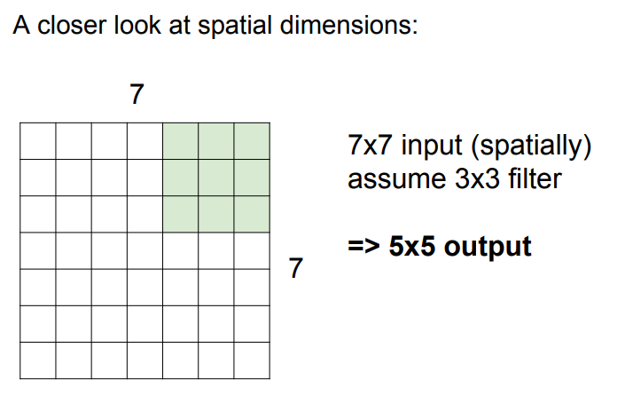

Slide 26
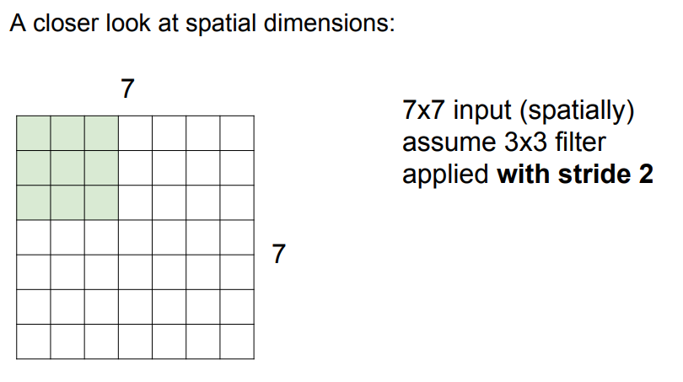

Slide 27
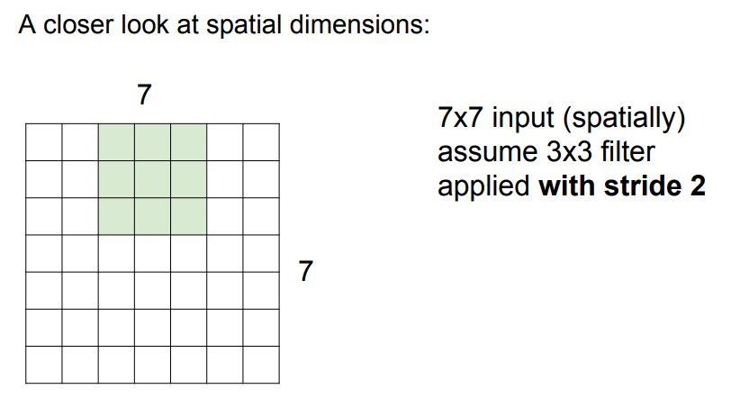

Slide 28
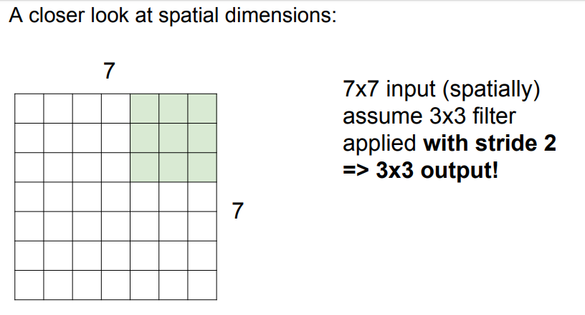

Slide 29
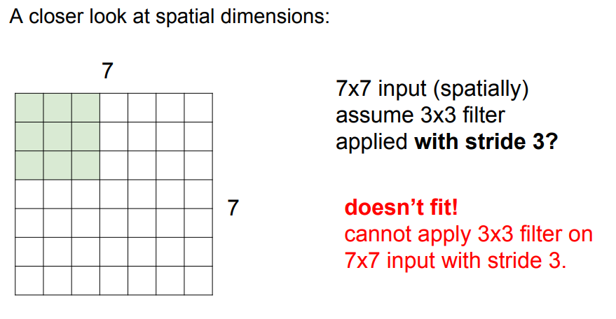

Slide 30
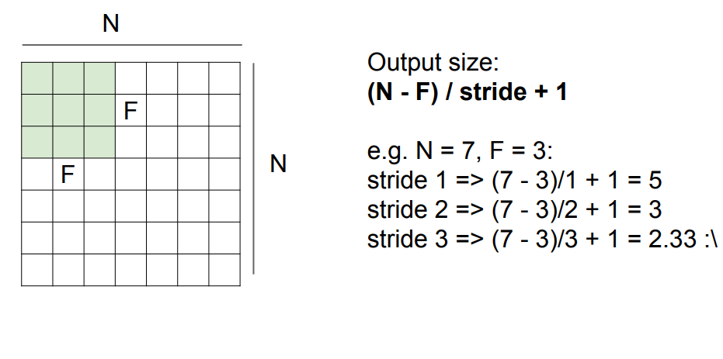

Slide 31
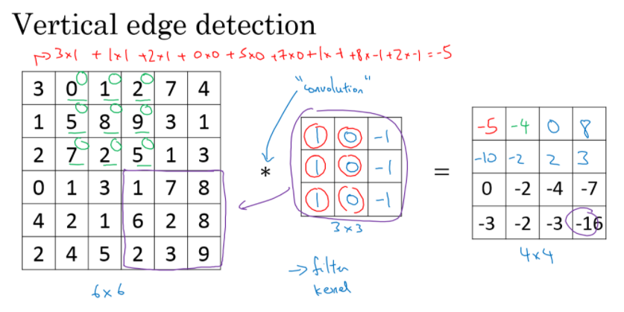
Convolution operation to detect vertical edges

Slide 32
Padding
The convolution operation shrinks the matrix if f>1.
We want to apply convolution operation multiple times, but if the image shrinks we will lose a lot of data on this process. Also the edges pixels are used less than other pixels in an image.
So the problems with convolutions are:
Shrinks output.
throwing away a lot of information that are in the edges.
To solve these problems we can pad the input image before convolution by adding some rows and columns to it. We will call the padding amount P the number of row/columns that we will insert in top, bottom, left and right of the image.
In almost all the cases the padding values are zeros.
The general rule now, if a matrix nxn is convolved with fxf filter/kernel and padding p give us n+2p-f+1, n+2p-f+1 matrix.

Slide 33
Strided convolution
When we are making the convolution operation we used S to tell us the number of pixels we will jump when we are convolving filter/kernel. The last examples we described S was 1.
if a matrix nxn is convolved with fxf filter/kernel and padding p and stride s it give us (n+2p-f)/s + 1,(n+2p-f)/s + 1 matrix.

Slide 34
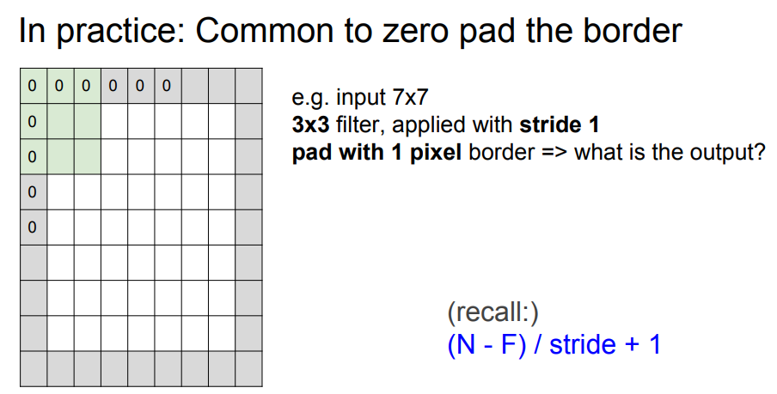

Slide 35
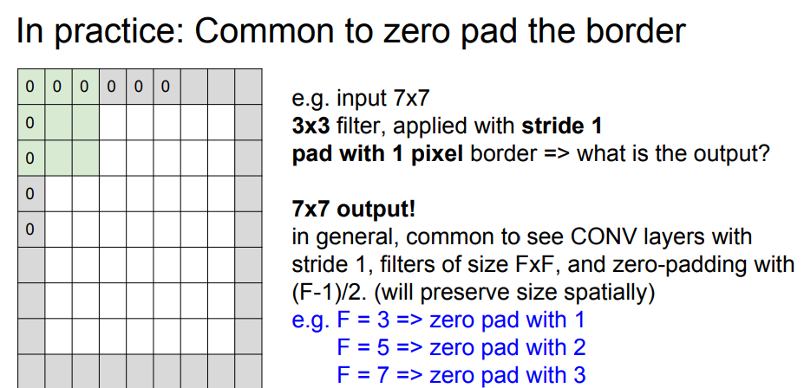

Slide 36
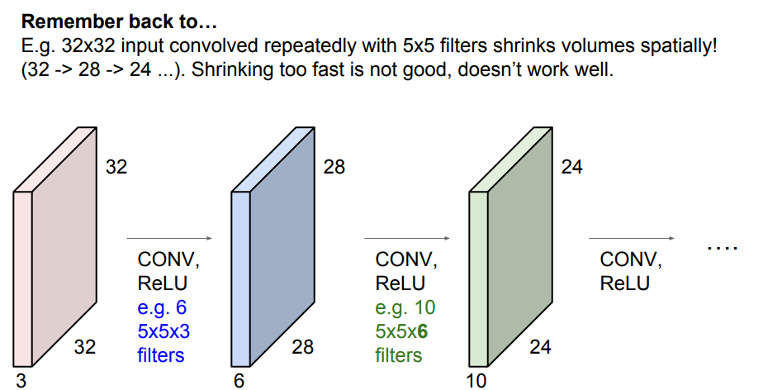

Slide 37
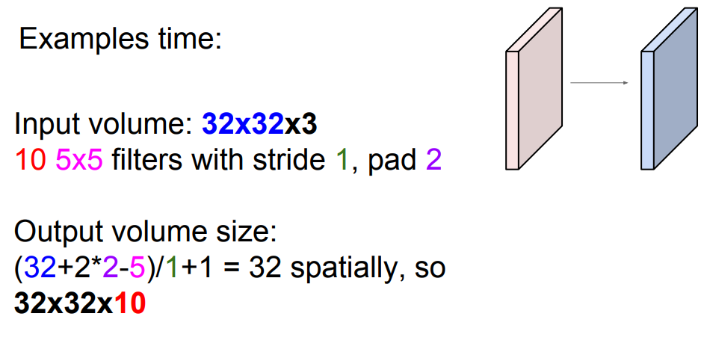

Slide 38
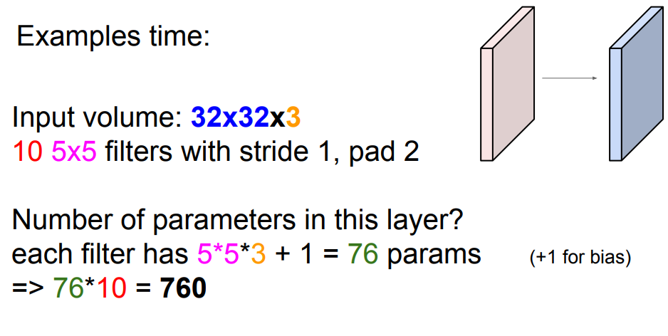

Slide 39
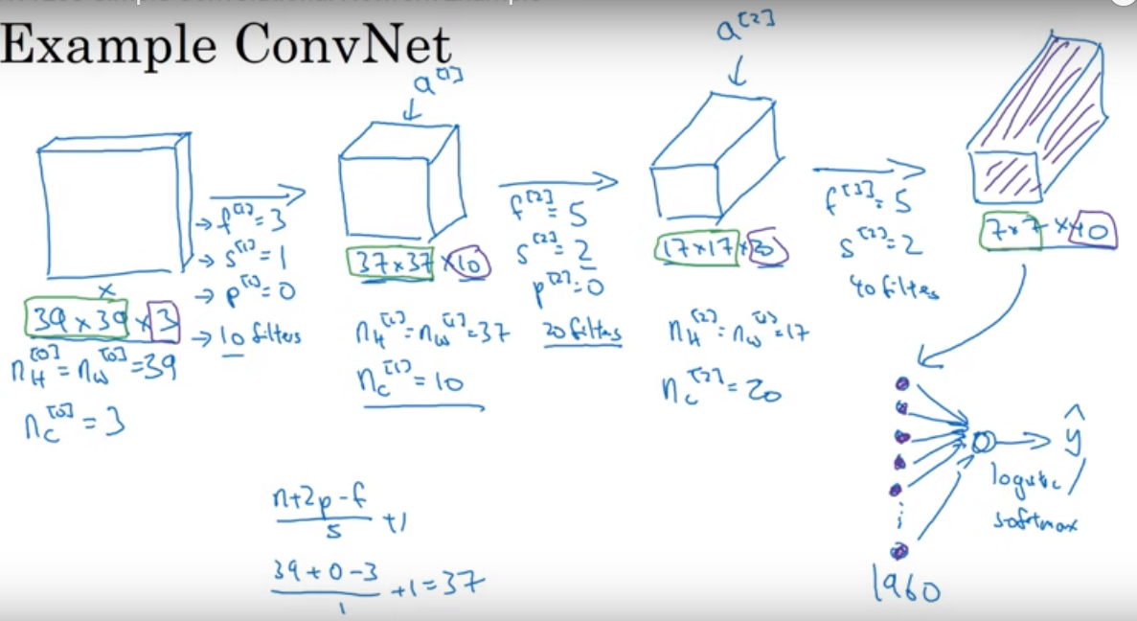

Slide 40
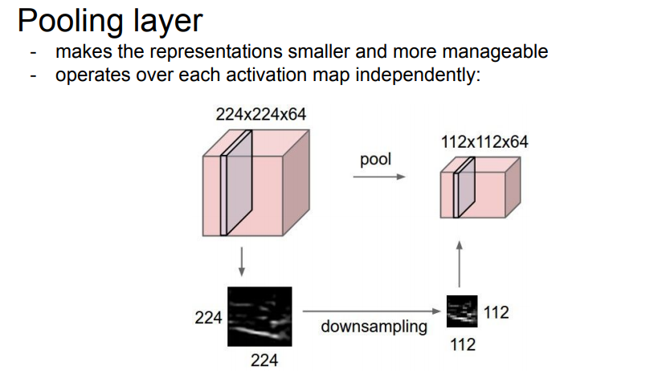

Slide 41
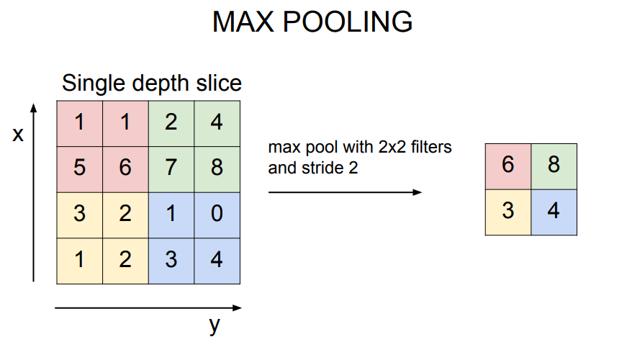

Slide 42
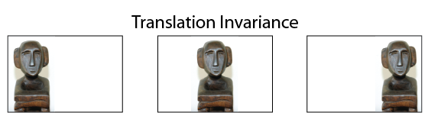
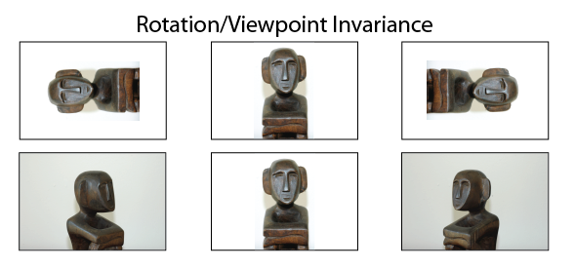
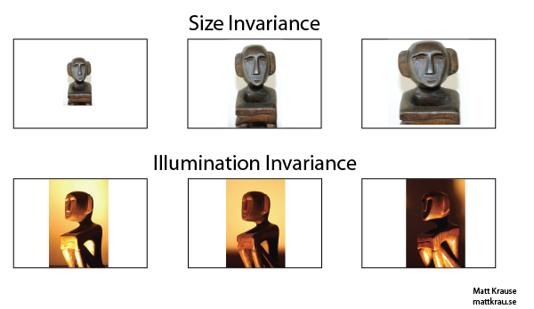

Slide 43
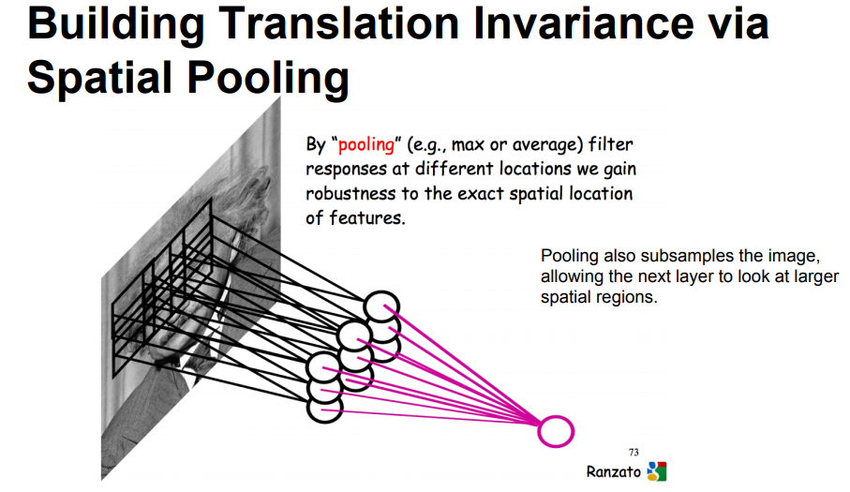

Slide 44
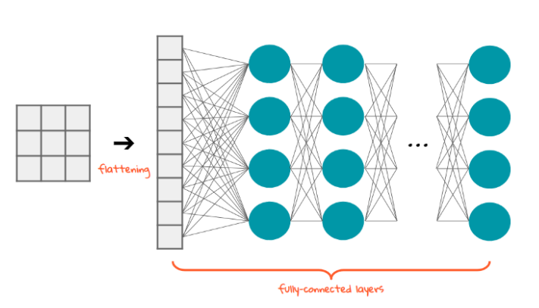
Classification — Fully Connected Layer (FC Layer)

Slide 45
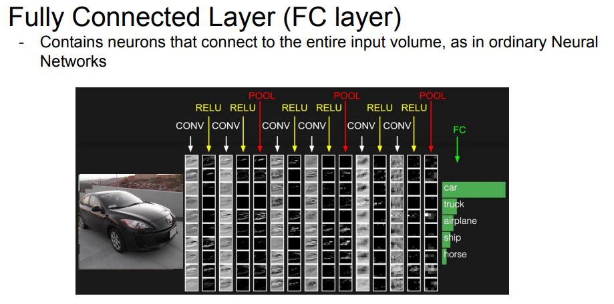

Slide 46
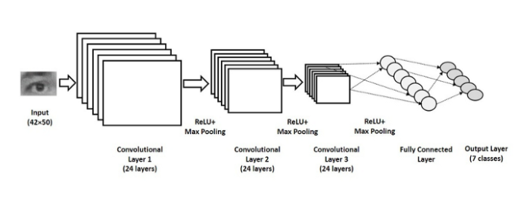
CNN in One Shot

Slide 47
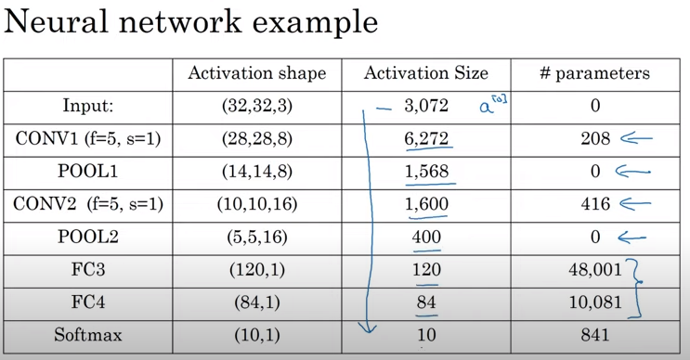

Slide 48
References
https://en.wikipedia.org/wiki/Deep_learning
Fei-Fei Li & Justin Johnson & Serena Yeung, Lecture 5 - 26 April 18, 2017
Andrew Ng (C4W1L08 Simple Convolutional Network Example)
http://www.cs.umd.edu/~djacobs/CMSC733/CNN.pdf
https://towardsdatascience.com/a-comprehensive-guide-to-convolutional-neural-networks-the-eli5-way-3bd2b1164a53

